Slide 1










TABLES
RECORDS
OVERVIEW
DATABASE ORGANIZATION
KEYS
FIELDS
Key Components
INDEXES
RELATIONSHIPS

Slide 2






DATA ORGANIZATION FLOW
Raw Data
Tables
Records
Fields
Indexed DB
Unstructured information enters the database system. This includes text, numbers, dates, and other data types collected from various sources before processing.
Data is organized into tables - structured grids with rows and columns. Each table represents a specific entity like customers, products, or orders.
Each row in a table is a record representing one complete entry. A customer record contains all information about a single customer.
Fields are the columns that define what data each record contains. Examples include name, email, date, and ID fields with specific data types.
Indexes are created on frequently searched fields for faster retrieval. The organized database enables efficient queries and data management.
01
02
03
04
05

Slide 3
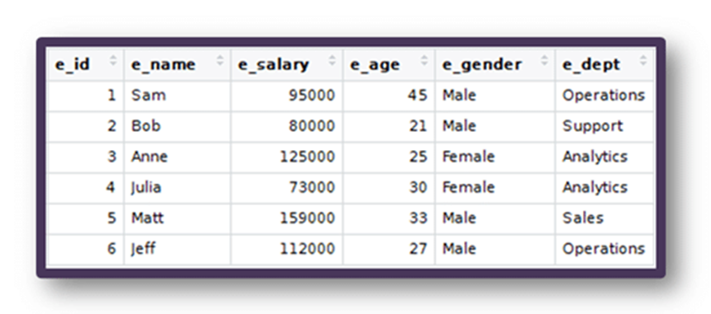
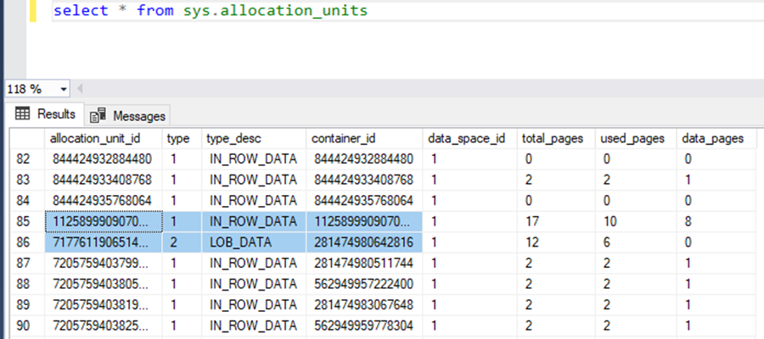
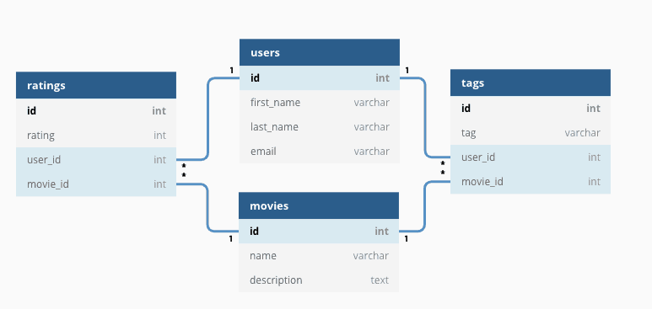
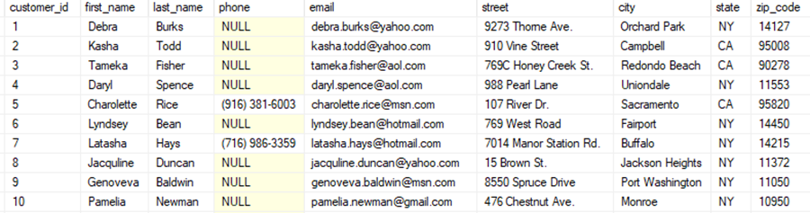

Slide 4










BENEFITS OF DATABASE ORGANIZATION
Fast Queries
Data Integrity
Scalability
Easy Maintenance
Reduced Redundancy
Well-organized databases with proper indexing enable lightning-fast data retrieval. Queries execute efficiently, reducing wait times and improving application performance significantly.
Structured organization ensures data accuracy and consistency. Constraints, relationships, and validation rules maintain reliable information across all database operations.
Properly organized databases grow seamlessly with your needs. Good structure allows for easy expansion, handling increased data volumes without performance degradation.
Clear organization simplifies updates, backups, and troubleshooting. Database administrators can quickly locate issues and implement changes with minimal disruption.
Normalization eliminates duplicate data storage. This saves space, prevents inconsistencies, and ensures that updates only need to be made in one location.

